Slide 1


Signals & Systems For Computer Engineering
Prof.Dr. B.Berk ÜSTÜNDAĞ
Istanbul Technical University
Faculty of Computer Engineering and Informatics
BLG354E / CRN: 21615
6th Week Lecture (cont.)
2020
bustundag@itu.edu.tr
BLG354E / CRN: 21560
10th Week Lecture

Slide 2
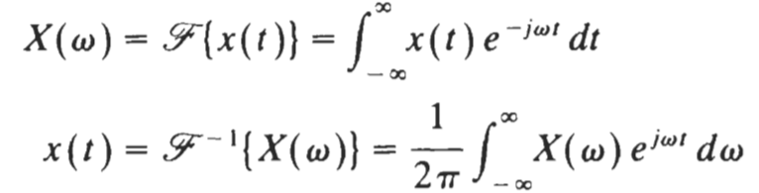
Common Fourier Transform Pairs
x(t) and X(ω) form a Fourier transform pair denoted by
x(t) ↔ X(ω)
BLG354E - İTÜ Faculty of Computer Engineering and Informatics - Üstündağ

Slide 3


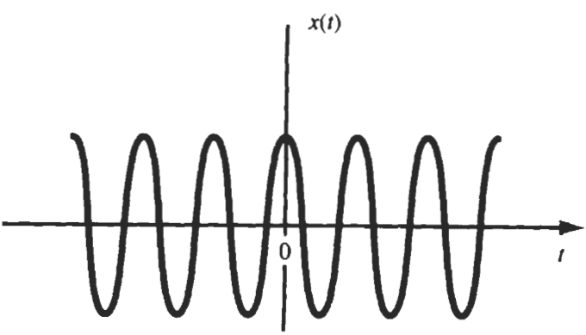
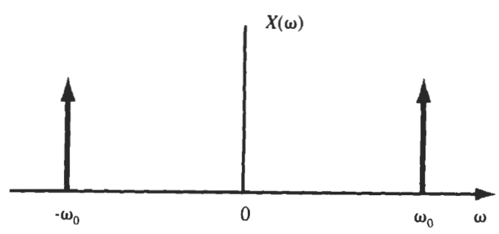
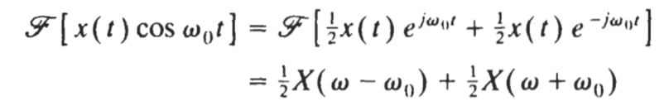
Find the Fourier Transform of the signal x(t)=cos(ω₀t)
By using linearity property,
This is why sinusoidal modulation signals are used in bandwidth limited communication systems

Slide 4
Application Fields of the Fourier Transform in Engineering
Communication systems and devices : Analog and digital filters, spectral Analysis, modulation, Software Defined Radio, BW management, cognitive radio, signal quality
Machine Learning : Spectral feature extraction, abstraction
Data Processing : Data compression (derivatives Cosine transform, DFT, FFT)
Image processing : Transformation , representation , encoding , smoothing and sharping images, Image analysis. 2 or higher dimensional Fourier Transform are being used in image processing
Data analystics : Time series prediction (DFT, FFT, STFT, ...) , high – pass , low-pass , and band-pass filters. Signal and noise (SNR) estimation by encoding the time series, .
Energy systems and electronic devices: Harmonic analysis, filtering, stability analysis, energy and signal quality management
Mechanical systems : Vibration analysis and management, structural diagnostics, design methods
Control systems : Frequency response, regulators stability analysis, frequency domain control
………
BLG354E - İTÜ Faculty of Computer Engineering and Informatics - Üstündağ

Slide 5
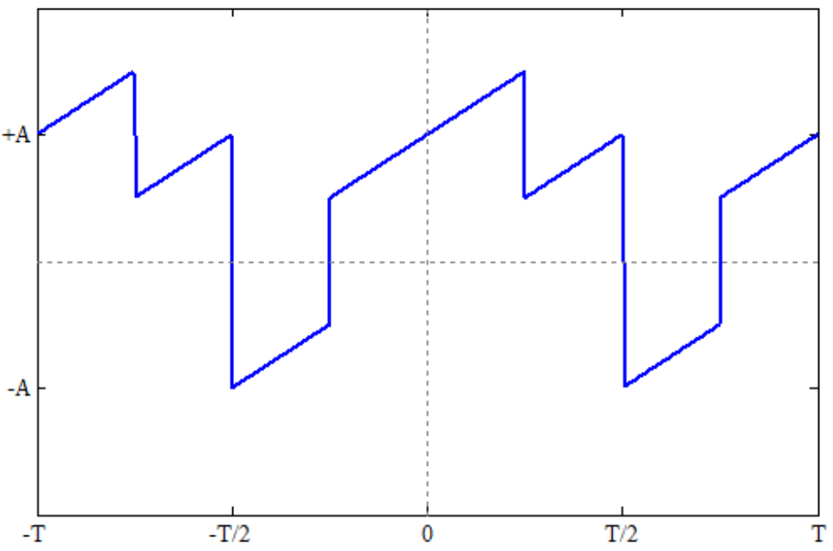

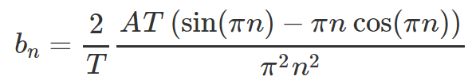
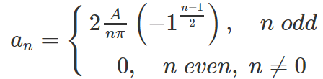

This signal pattern is neither even nor odd
Example:
Find the Fourier Series representation of the signal that is
sum of sawtooth and square waves (50% duty cycle)
x(t)
A=1
T_{on}/T=0.5
t
-T/2
T/2
A=1
t
-T/2
T/2
a₀=0.5
BLG354E - İTÜ Faculty of Computer Engineering and Informatics - Üstündağ

Slide 6


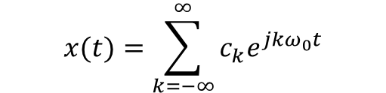
n=k | 0 | 1 | 2 | 3 | 4 | 5 | 6 | 7
a_{n} | 0.5 | 0.6366 | 0 | -0.2122 | 0 | 0.1273 | 0 | -0.0909
b_{n} | ---- | 0.6366 | -0.3183 | 0.2122 | -0.1592 | 0.1273 | -0.1061 | 0.0909
n=k | -7 | -6 | -5 | -4 | -3 | -2 | -1 | 0 | 1 | 2 | 3 | 4 | 5 | 6 | 7
c_{n} | -0.0455 + 0.0455j | -0.0531j | 0.0637 + 0.0637j | -0.0796j | -0.1061 + 0.1061j | -0.1592j | 0.3183 + 0.3183j | 0.5 | 0.3183 - 0.3183j | 0.1592j | -0.1061 - 0.1061j | 0.0796j | 0.0637 - 0.0637j | 0.0531j | -0.091
where c_{k} are complex Fourier coefficients
$$x(t)=\sum_{k=−∞}^{∞}{c_{k}e^{jkω_{0}t}}$$
BLG354E - İTÜ Faculty of Computer Engineering and Informatics - Üstündağ

Slide 7
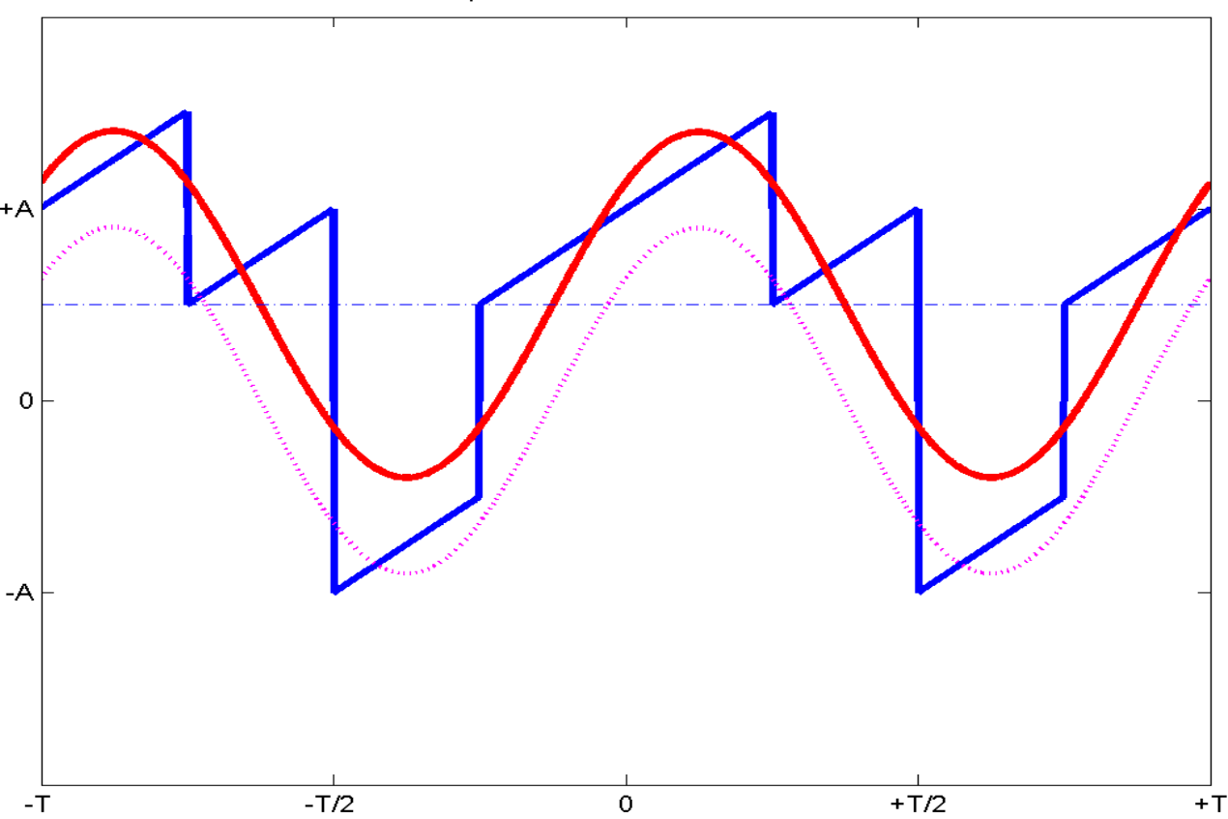
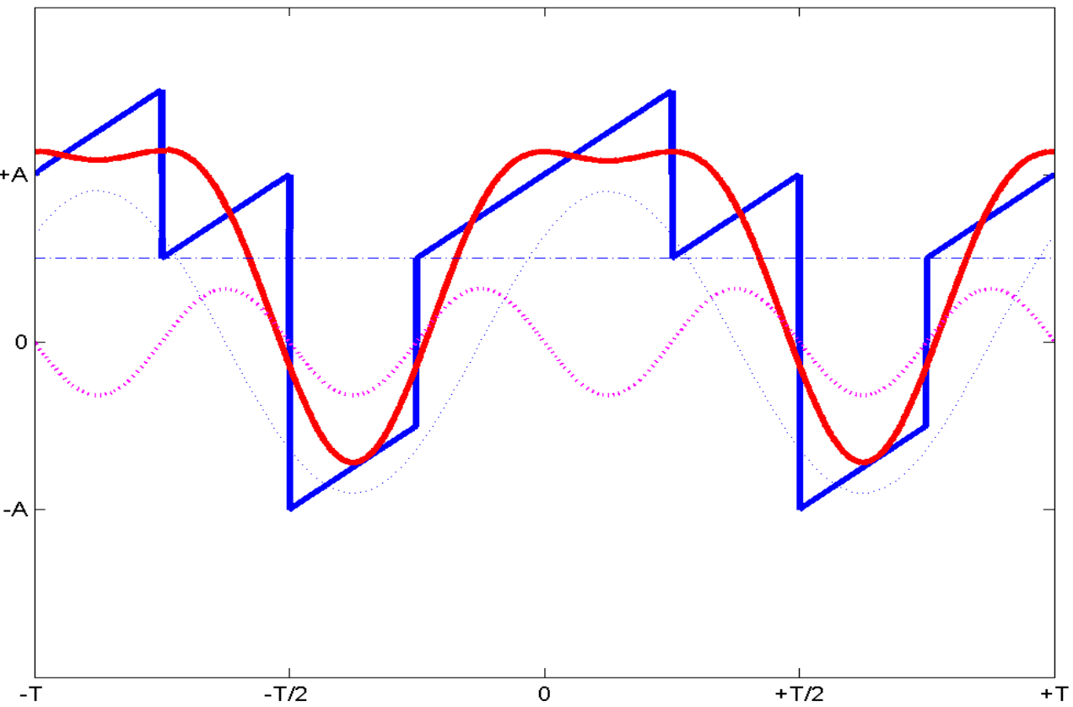

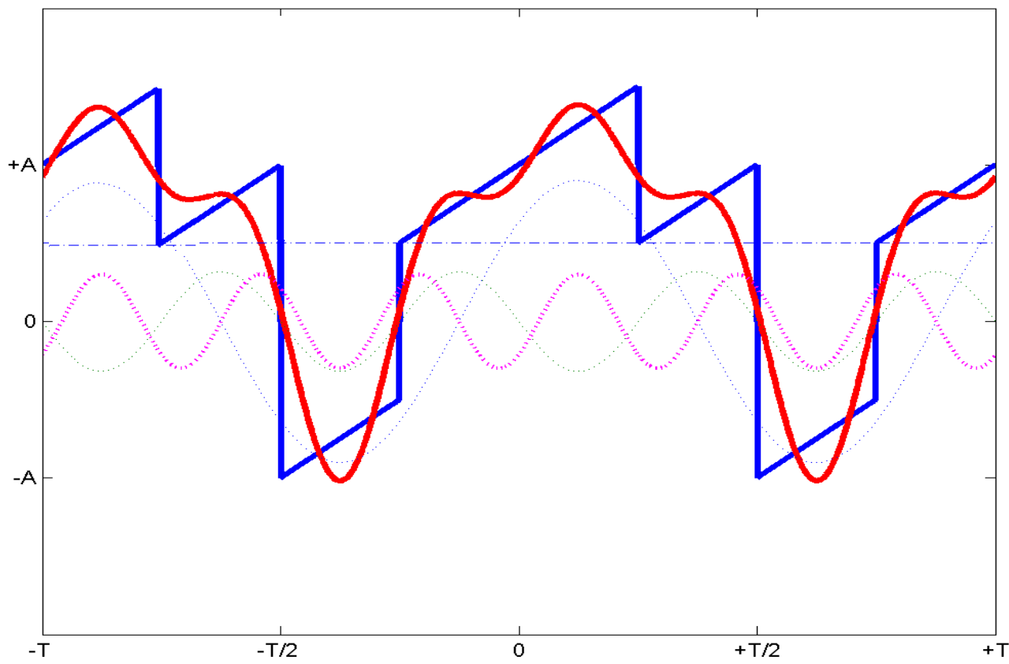

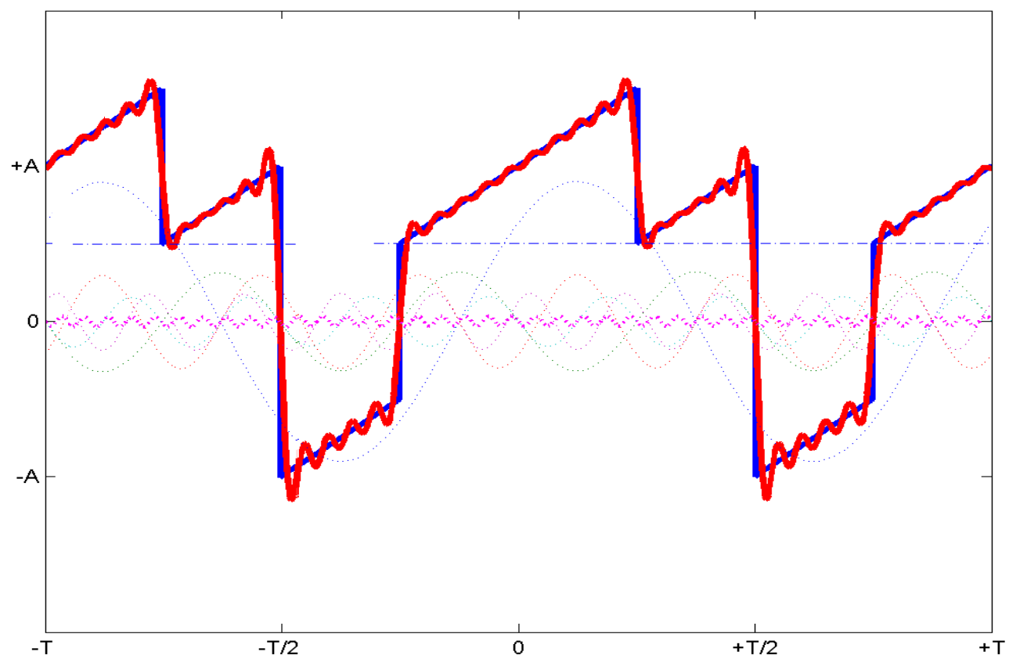
signal x(t)
signal x(t)+1st harmonic
signal x(t)+1st+2nd harmonics
signal x(t)+1st+2nd+3rd harmonics
signal x(t)+1st+2nd+3rd+4th harmonics
signal x(t)+1st+2nd+3rd+…+20th harmonics
Gibb’s overshoot
BLG354E - İTÜ Faculty of Computer Engineering and Informatics - Üstündağ

Slide 8
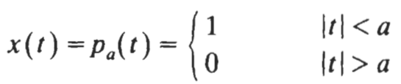
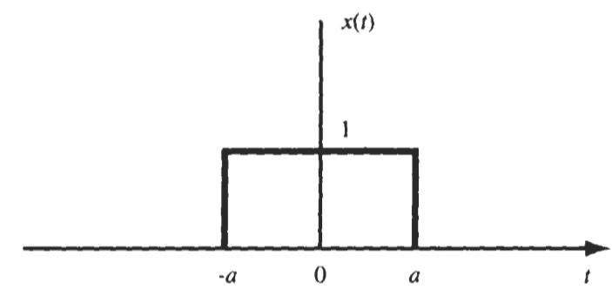

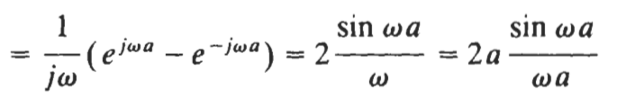
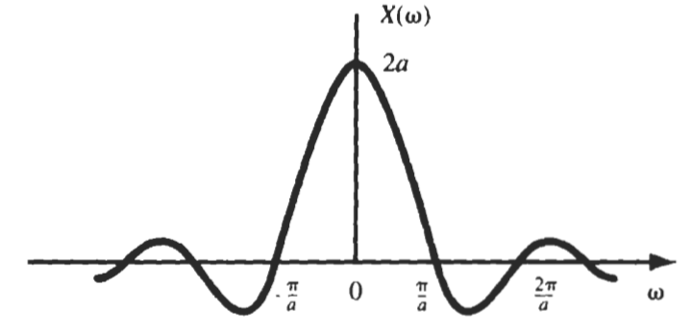
Let us find the Fourier transform of the rectangular pulse signal
BLG354E - İTÜ Faculty of Computer Engineering and Informatics - Üstündağ

Slide 9

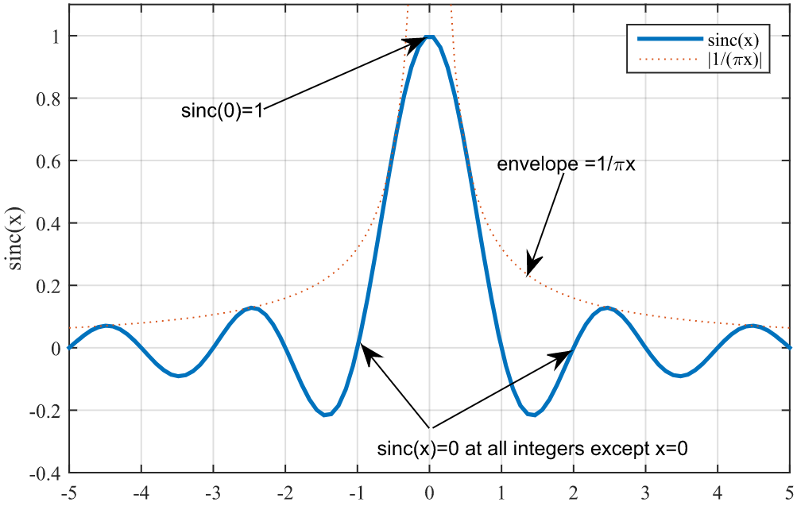
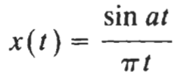


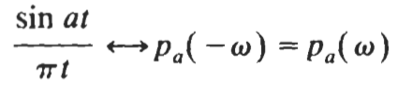
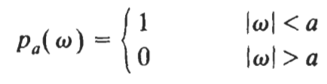
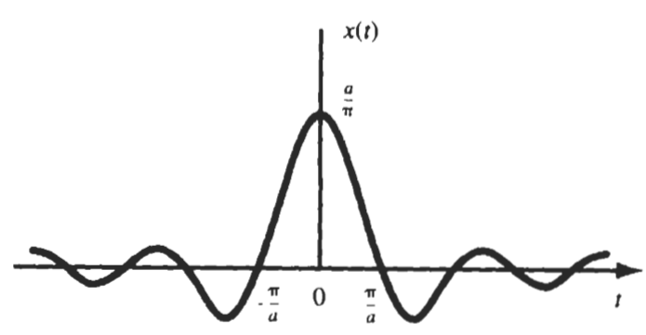
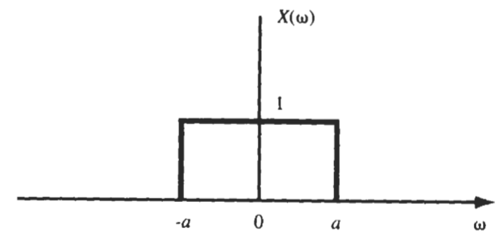
Let us find the Fourier transform of the sinc(x) function where
By the duality property,
Divide both sides by 2π
→
Since,
BLG354E - İTÜ Faculty of Computer Engineering and Informatics - Üstündağ

Slide 10

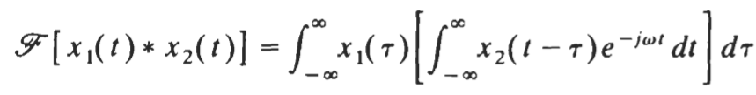
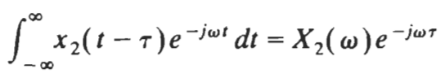


Prove the convolution theorem by using Fourier Transform properties
x₁(t)*x₂(t) ↔ X₁(ω)·X₂(ω)
By the definition,
By changing the order of integrations we get,
By the time shifting property →
Therefore
x₁(t)*x₂(t) ↔ X₁(ω)·X₂(ω)
BLG354E - İTÜ Faculty of Computer Engineering and Informatics - Üstündağ

Slide 11
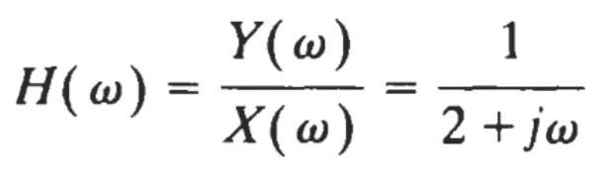

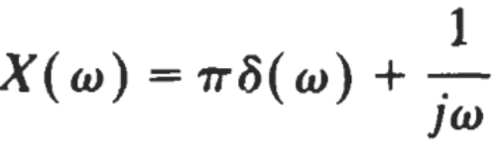
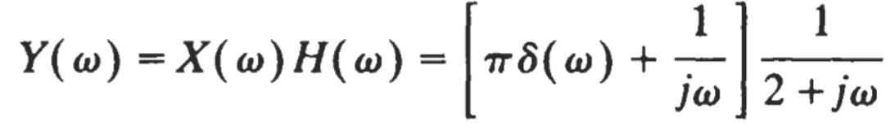
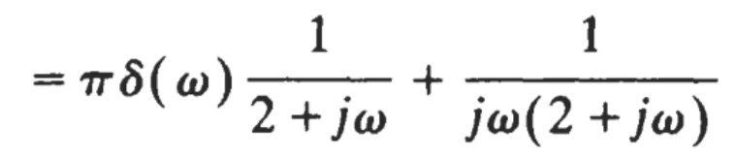
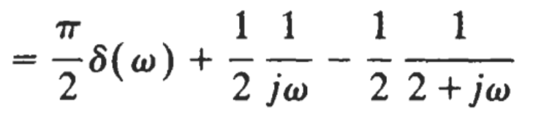
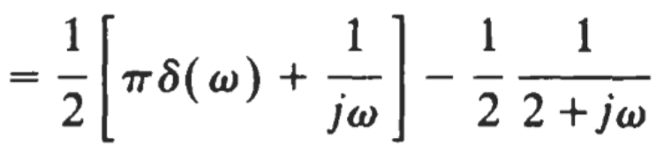

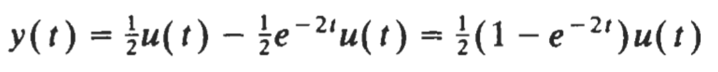

Example:
$$\frac{dy(t)}{dt}+2y\left(t\right)=x(t)$$
describes the input x(t) – output y(t) relationship of an LTI system
Find the transfer function of this system in frequency domain
Find the output of this system y(t), in time domain, for x(t)=u(t)
Write pseudo code that emulates this system on a computer for the sampling period T_{s} (Exercise)
Fourier transform of the system
→
Fourier transform of the input signal x(t)=u(t)
→
Output of the system for the specified input signal:
By using partial fraction expansion method: Y(ω)
Since
we get
Y(ω)
Hence by using the table:
(Remark: using the Laplace transform could be easier due to transform of u(t) )
BLG354E - İTÜ Faculty of Computer Engineering and Informatics - Üstündağ

Slide 12






Ideal Low Pass Filter (LPF) is characterized by
Find the output of ideal LPF for the input x(t)=sinc(t)
*
M(ω)
[dB]
M(ω)
[dB]
↓
×
LPF in practice
Ideal LPF
sinc→a=π
0dB
0dB
-40dB/dec
ω_{c}
ω(rad/s)
ω_{c}
ω(rad/s)
When ω_{c}>a →
→
When ω_{c}<a →
→
BLG354E - İTÜ Faculty of Computer Engineering and Informatics - Üstündağ
BLG354E - İTÜ Faculty of Computer Engineering and Informatics - Üstündağ

Slide 13

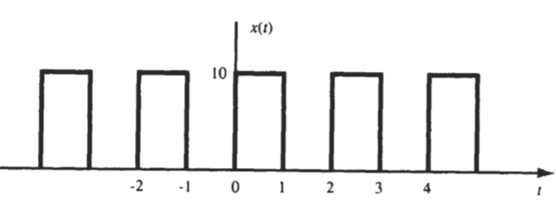


Find the output of ideal LPF H(ω) for the below given periodic input signal where
Trigonometric Fourier Series is given by
As previously shown x(t)
Where A=10 and ω₀=π here for the given x(t)
→
Since angular frequency ω>4π will be rejected by the given ideal LPF,
output y(t) will be consisting of harmonics having angular frequency less than 4π.
BLG354E - İTÜ Faculty of Computer Engineering and Informatics - Üstündağ

